Slide 1
Shopping Platform
Tomasz Touma G00439630
Bogdan Tabalae G00436707
Maciej Stech G00428784

Slide 2
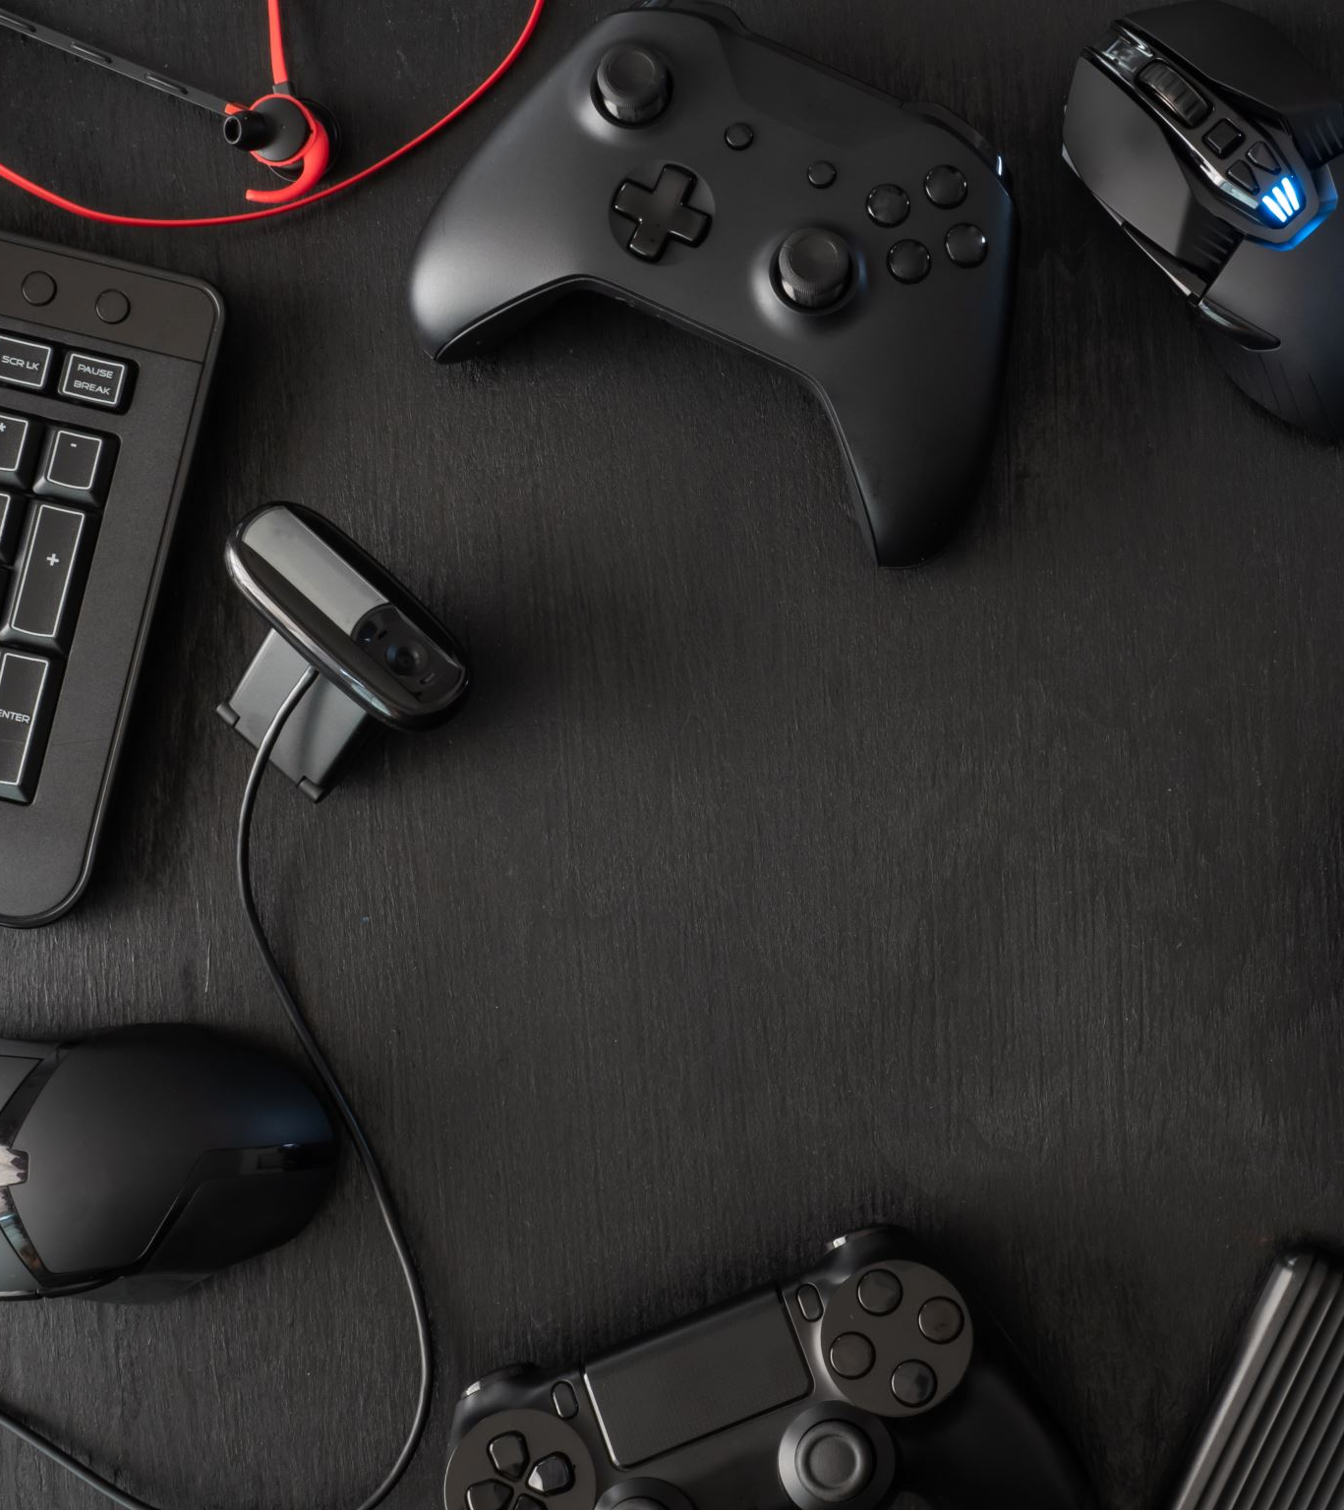
Project Description
A full-stack online game key marketplace developed with Angular, Spring Boot, and Supabase, allowing users to browse products, register accounts, and securely purchase digital game codes through a responsive web platform.

Slide 3
